Slide 1
Softball NZ Scorers Uniform Apparel
Polo Shirts Grey
Polo Shirts Black
Gym Shorts

Slide 2
Wet Weather Jacket
Wet Weather Tracksuit Paints
Track suit Pants
Plain Black no Logo

Slide 3
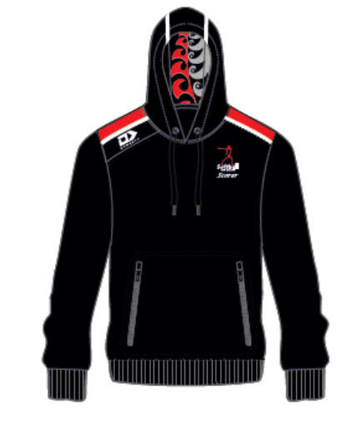
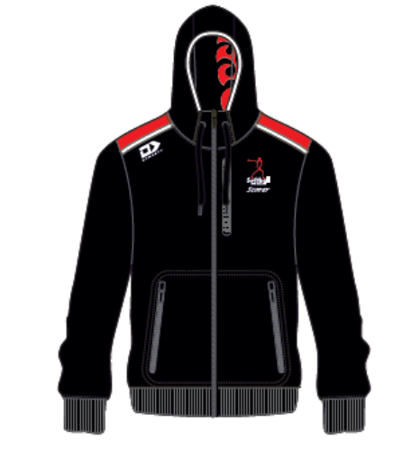
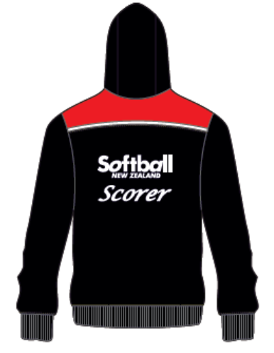
Bucket Hat
Backpack
Hoodie
Zip Front Hoodie
Cap and Visor

